Slide 1
AI Hackathon 2024

Slide 2




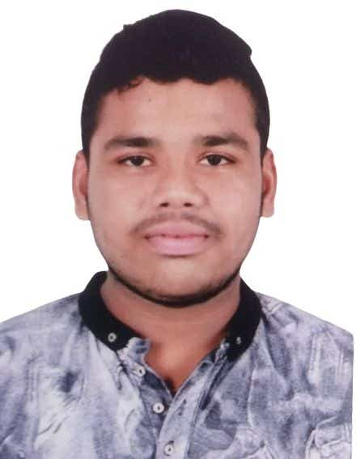
Team Introduction
Jignesh Dhandha
Mayank Chande
Dhiraj Kumar
Arpan Shukla
Abhishek Sirsolkar

Slide 3
Overview
In Industry, most common practice is to make No. series of transaction year, month wise inorder to maintain a particular pattern and structure.
We have developed a solution inorder to do automization with help of Microsoft Azure Open AI Service where user will give a format in which No. series line should be generated and with respect to that AI will give suggestion of No. series line which ultimately reduces manual efforts.
Inorder to use this solution, user need to select Generate Boolean on No. Series page and for selected records, AI will suggest No. series line.
In prompt page, user will enter Text in which No. Series line needs to be generated in particular format with help of AI.
System will generate output using Azure Open AI service and once Keep it button is clicked, system will update No. series line in Business Central.

Slide 4
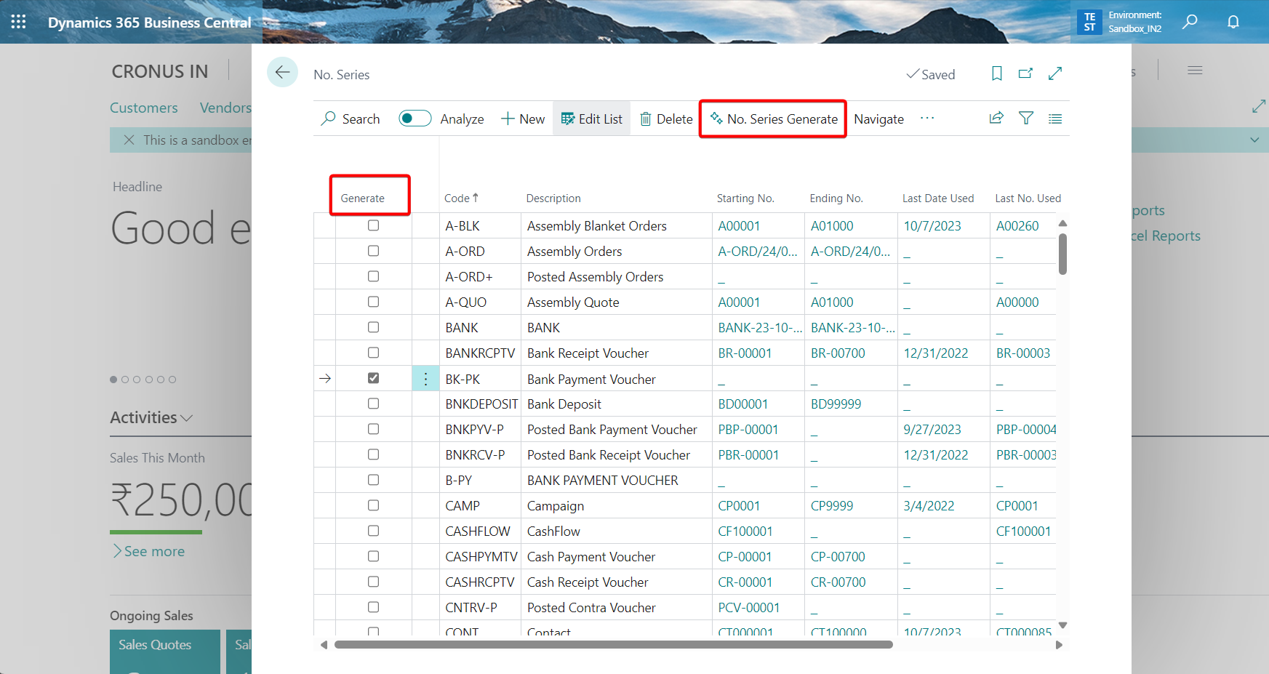
No. Series

Slide 5
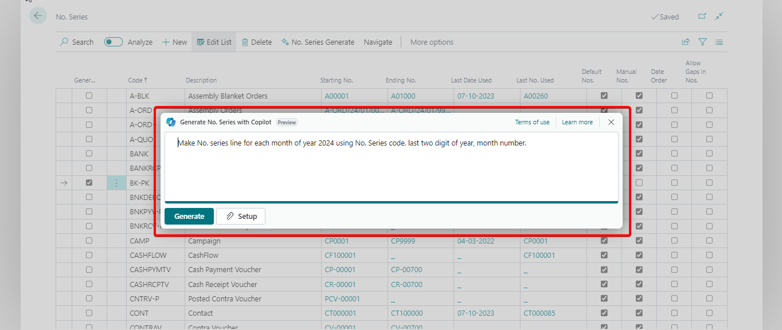
Input Text

Slide 6
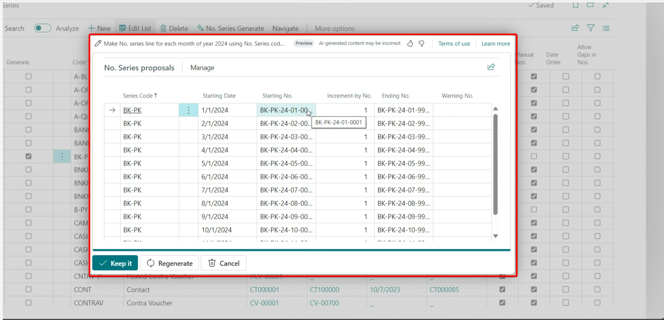
AI Suggestion

Slide 7
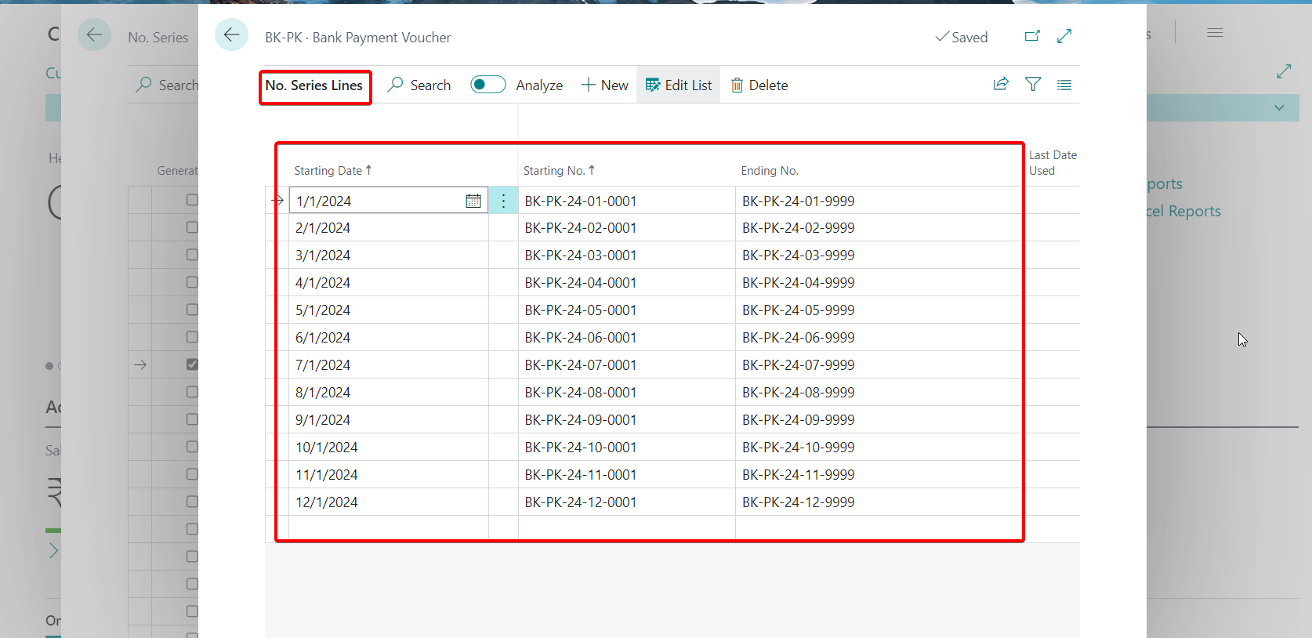
No. Series Lines Update

Slide 8
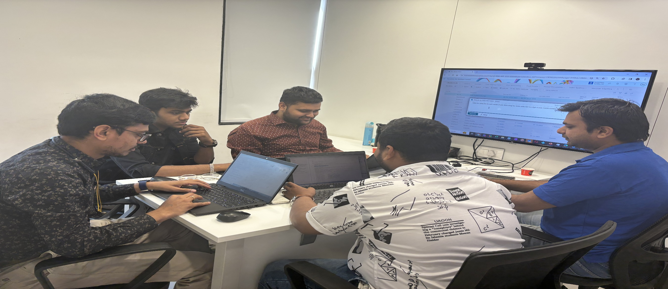
Team Photo

Slide 9
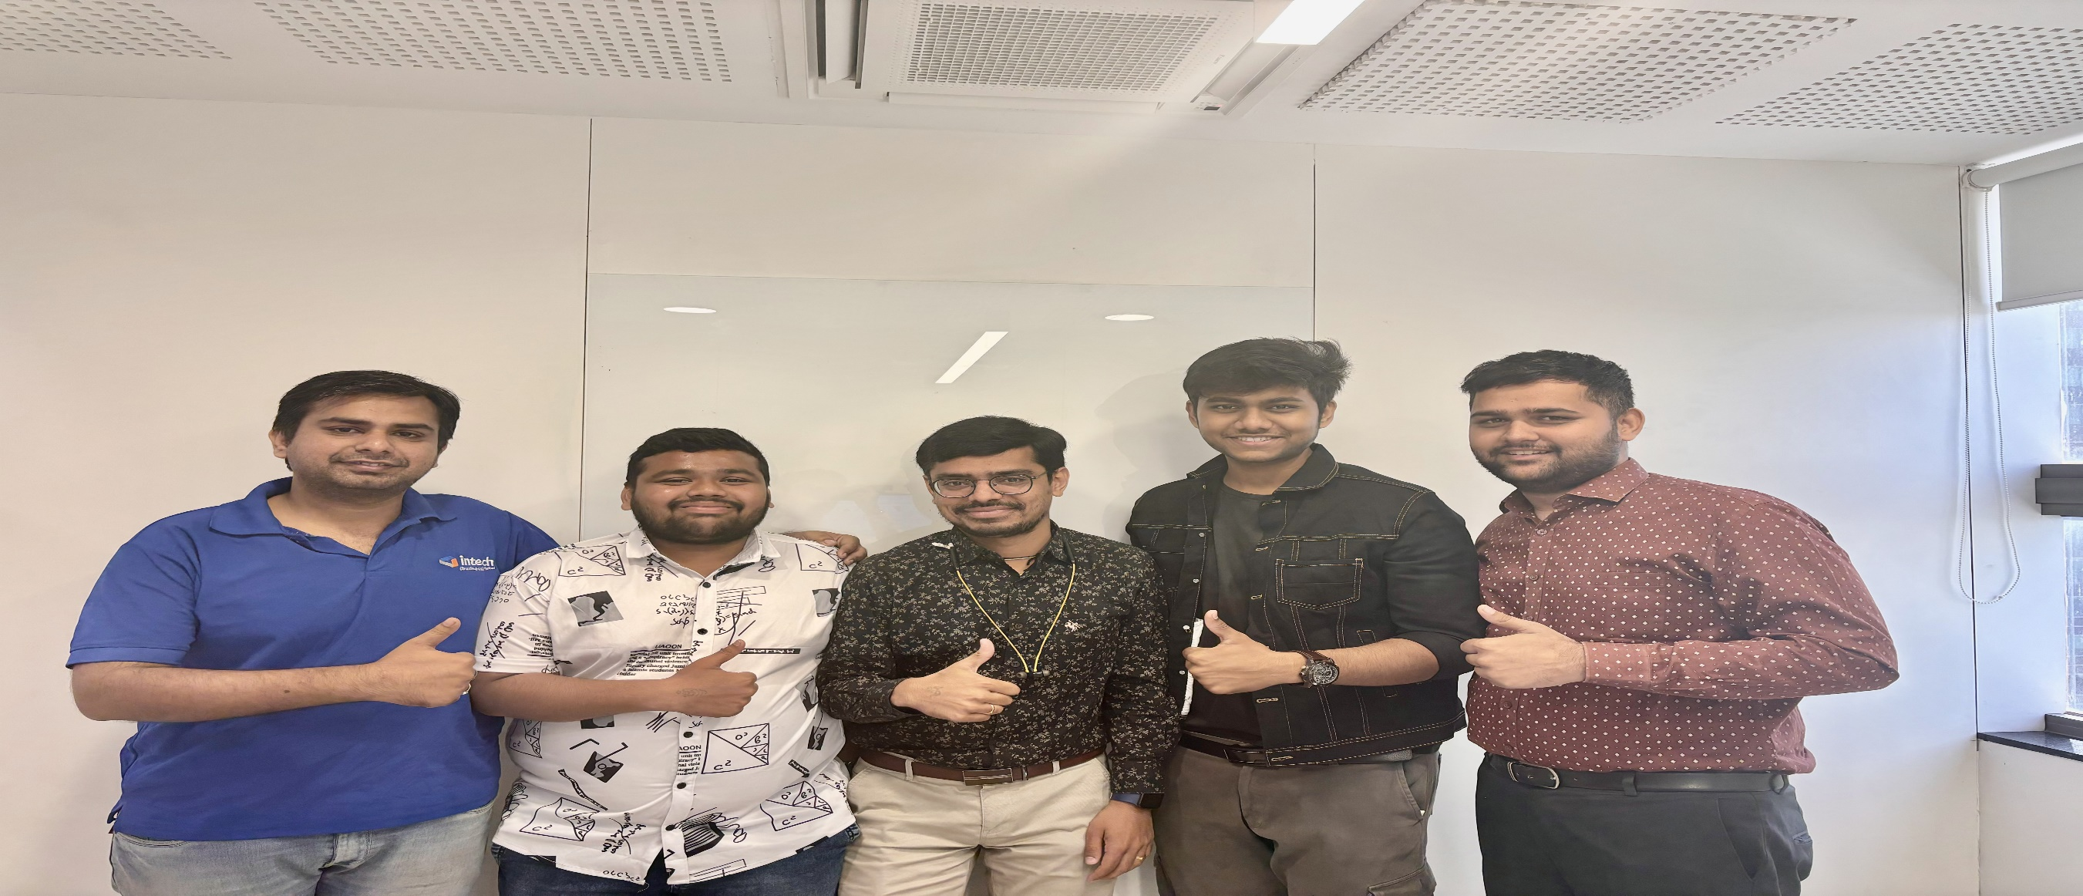
Team Photo

Slide 10
Thank You
sales@intech-systems.com | 079-6611-8965 | www.intech-systems.com

